Slide 1
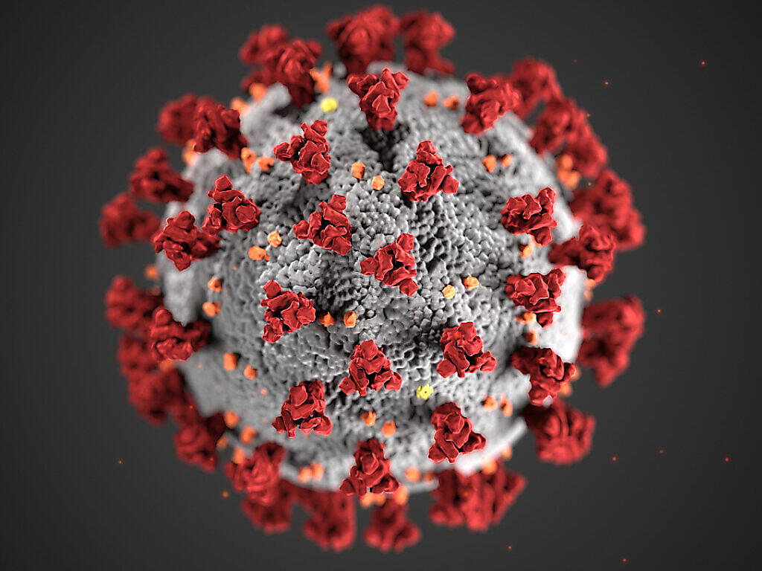

Covid-19 Risk Factor Prediction
Data Science
in Practice
R. Chaouche, Y. Martinson, C. Padovani, J.Triomphe

Slide 2
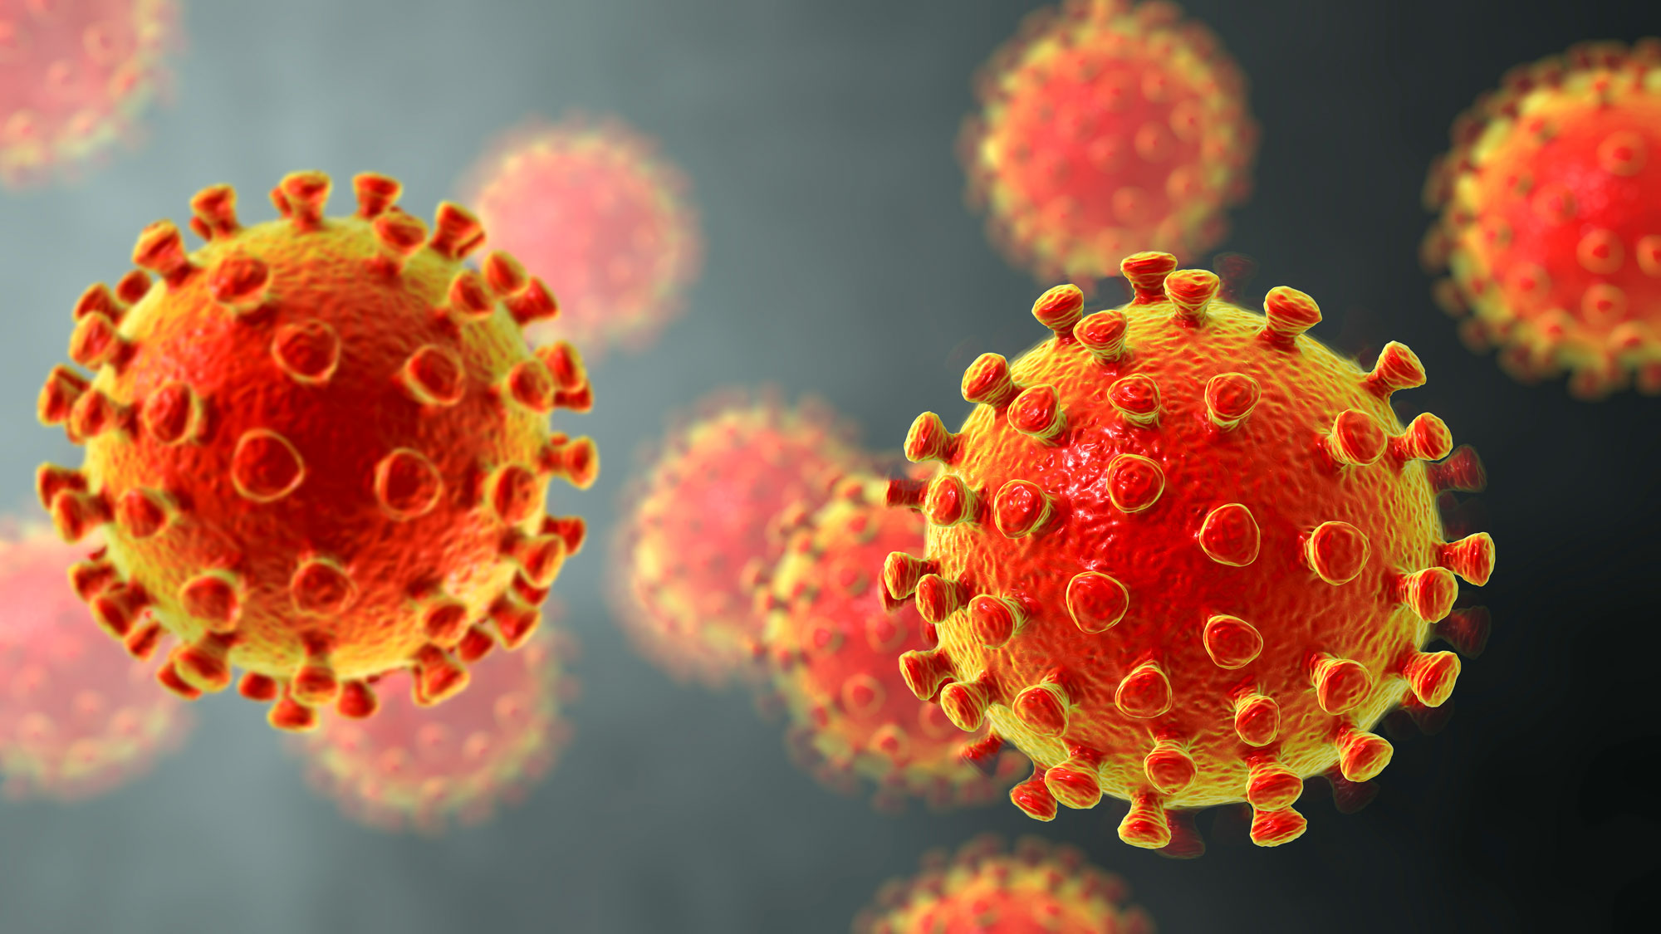
Context
Introduction
Problem description
Data Management
Network analysis
Random forest regression
Interpretations
Conclusion

Slide 3
Introduction

Slide 4
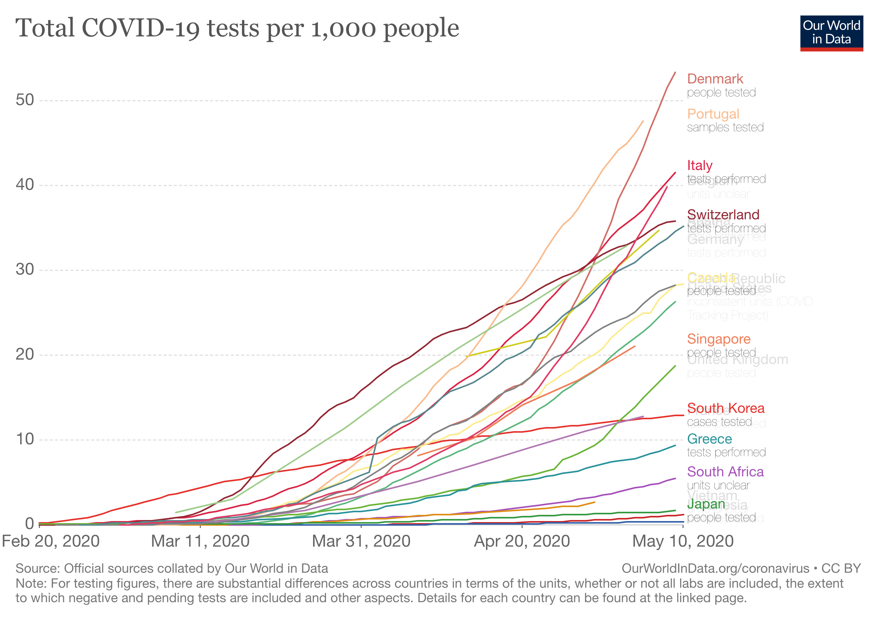
Introduction
➝ Virus has been spreading worldwide
4 million confirmed cases
Over 265,000 deaths
➝ Global Lock – down
Shut-down of large pans of the economy
Long-term implications
➝ Tests to target SARS-CoV-2

Slide 5
Problem Description

Slide 6

Understanding the need
➝ Health issues
High transmissibility and more than 265,000 deaths (06 May)
Risk factors diseases known but poor literature about drug targets*
➝ Expensive testing campaigns
$100 /genome tests
$30 million for testing Switzerland (35 test/1000 habitants)
➝ Tests do not have an optimal efficiency yet
* Specific molecule , usually a protein, to which the drug binds to produce its effect

Slide 7
Challenges
➝ Mapping a network of the major risk factor diseases for COVID-19
➝ Create a model to identify which targets of those risk factor diseases are more likely to be associated to COVID-19

Slide 8
Strategy
➝ Existing project from Kaggle
Predicted relation between diseases and COVID-19 with a score system
➝ Our project
Predicts relation between the targets of those diseases and the COVID-19

Slide 9
Expected outputs and outcomes
➝ Accurate network
Will help scientist figure out gene families.
Expected communities could focus on the most represented genes.
➝ Accurate prediction of targets to pay attention on
Will help doctors to avoid additionnal infection due to COVID-19
Will help to create more accurate tests

Slide 10
Data Set

Slide 11
Initial Data Set: Kaggle project (1)
➝ CORD-19 Dataset challenge
59,000 scholarly articles, including over 47,000 with full text, about COVID-19, SARS-CoV-2, and related coronaviruses created by The White House and a coalition of leading research groups
➝ Mondo Disease DataBase
Aggregates and merges genetic associations curated from both literature and newly-derived loci1 from UK Biobank
➝ Open Targets DataBase
Semi-automatically constructed ontology that merges in multiple disease resources to yield a coherent merged ontology

Slide 12
Initial Data Set: Kaggle project (2)
➝ Connects diseases
With other diseases
With drug targets
➝ Association scores between diseases and COVID-19

Slide 13
Data Reconstruction
➝ From the output of the previous study
Combine disease-target association score with disease-COVID-19 association score
Leverage the Open Targets Platform

Slide 14
Network Model

Slide 15
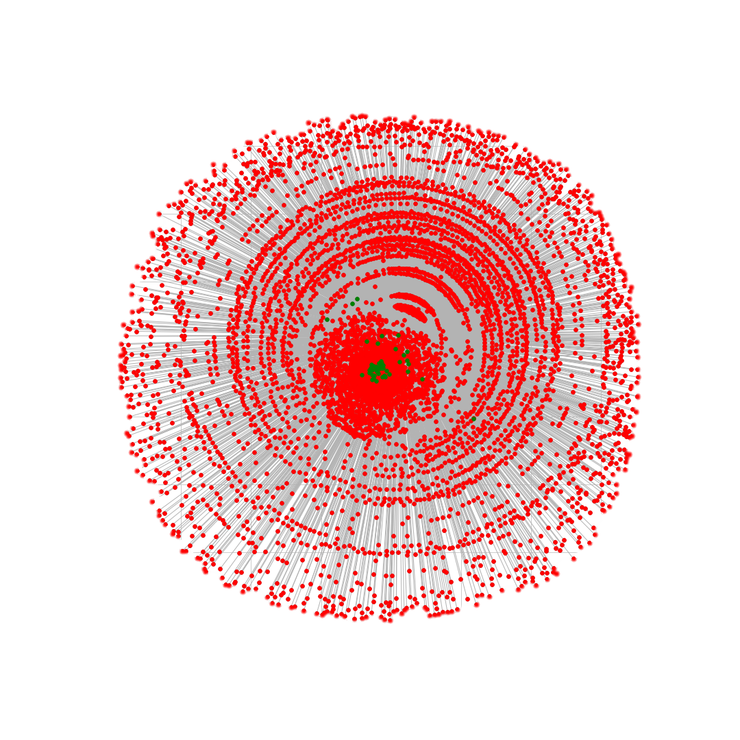
Model
➝ Dataset I
Nodes: Diseases, Genes
Edges: weighted score of gene on disease
Goal: Centrality ranking
Output: Overall Ranking

Slide 16
Model
➝ Centralities: Degree, Betweenness, Closeness, PageRank
➝ Scoring: Point ranking system for each node
➝ Positive: Finds key players in the network, robust
➝ Drawbacks: No Covid infos, unexpected outputs

Slide 17
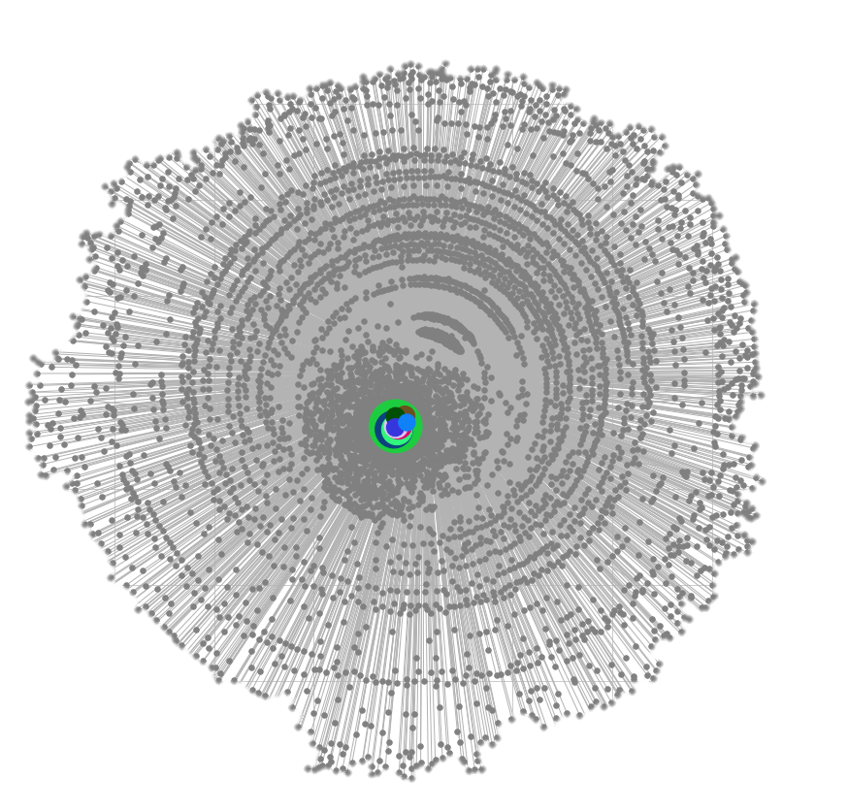
Results
➝ Very centered, close to gene locations
Bone Disease
Psychiatric Disorder
Biological process
Protein measurement
Diabetes Mellitus

Slide 18
Model
➝ Dataset II
Nodes: Diseases, Genes
Edges: weighted score of gene on disease
+ disease to disease
Goal: Central nodes own network
understanding + COVID-19 scoring comparison

Slide 19
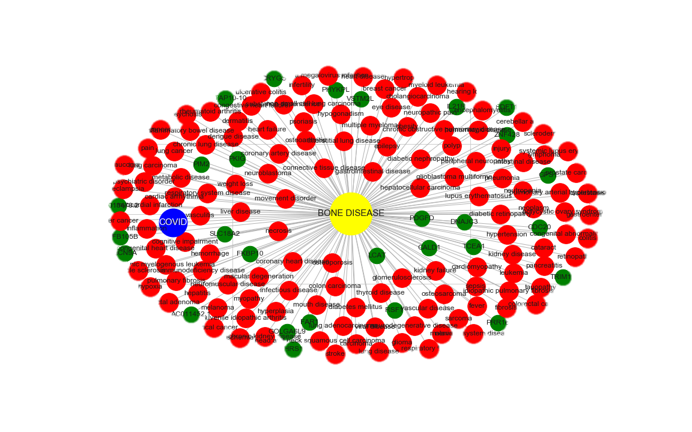
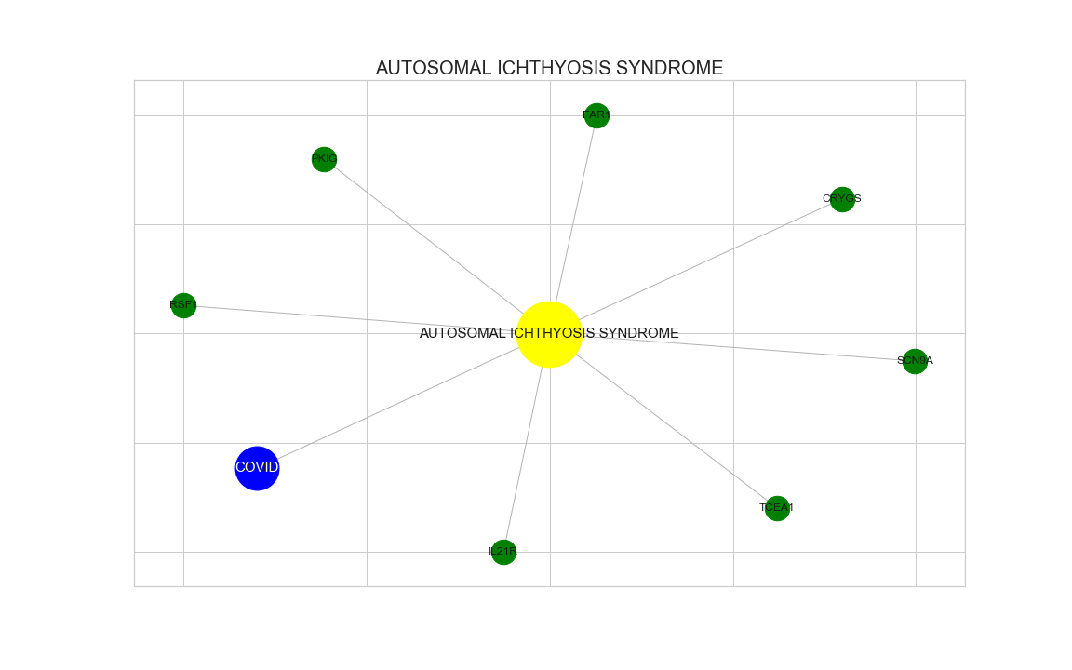
Results
1. Overall Ranking
1. Covid Ranking

Slide 20
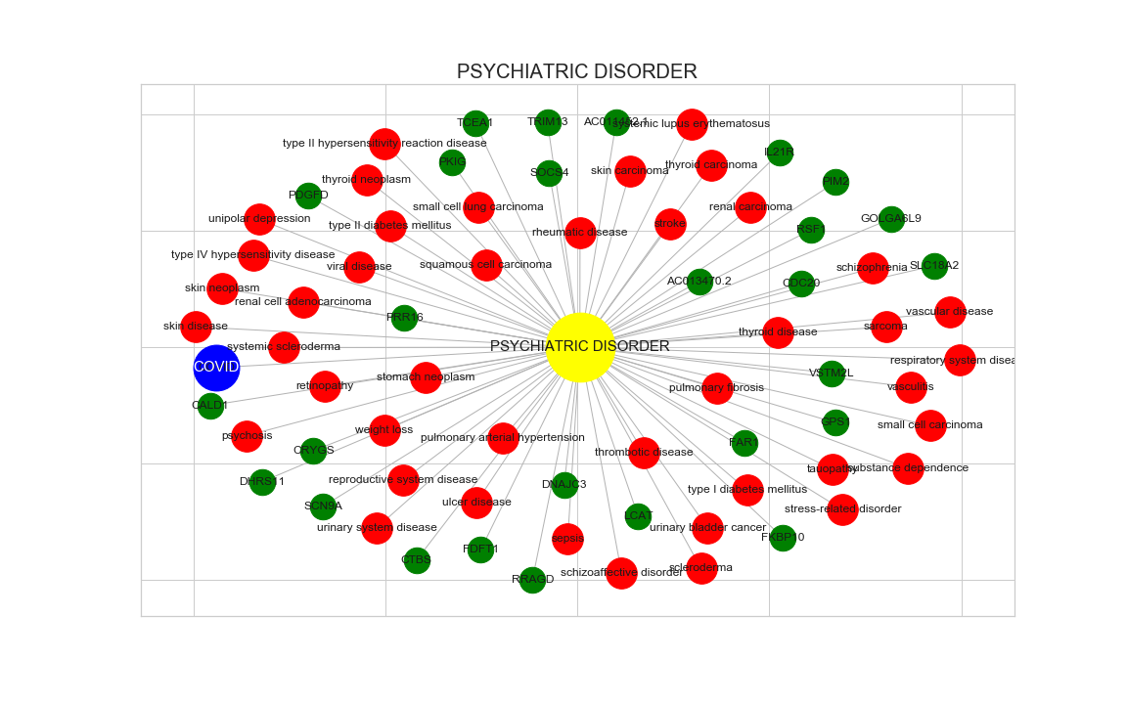
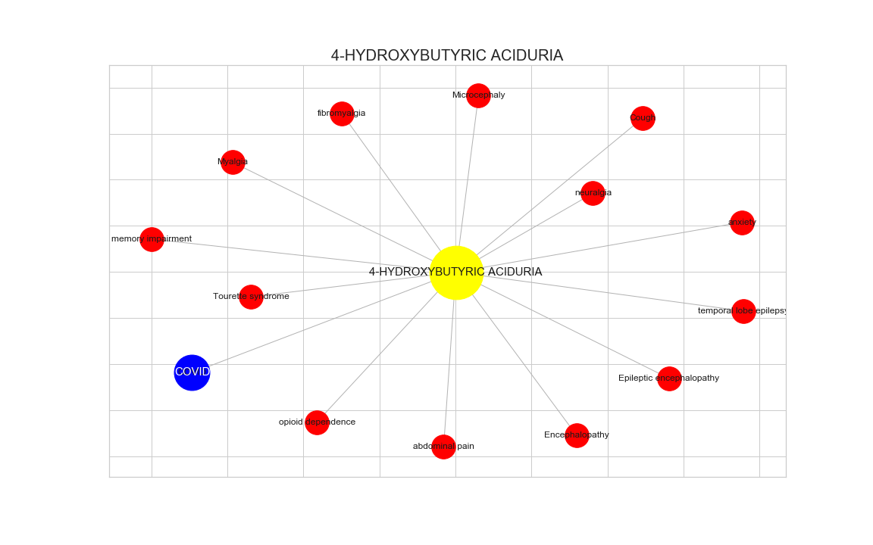
Results
2. Overall Ranking
2. Covid Ranking

Slide 21
Model
➝ Dataset II
Nodes: Communites
Edges: Covid score
Goal: Community influence

Slide 22
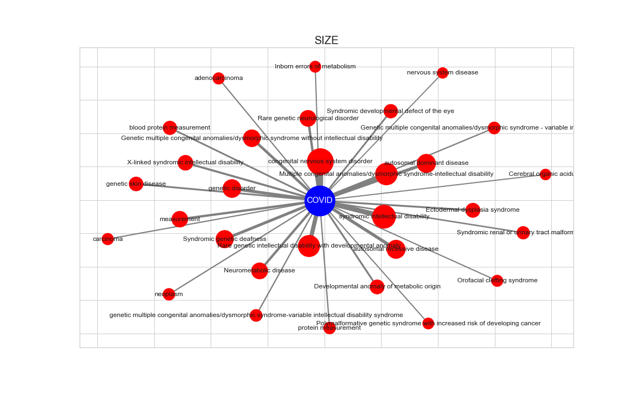
Results

Slide 23
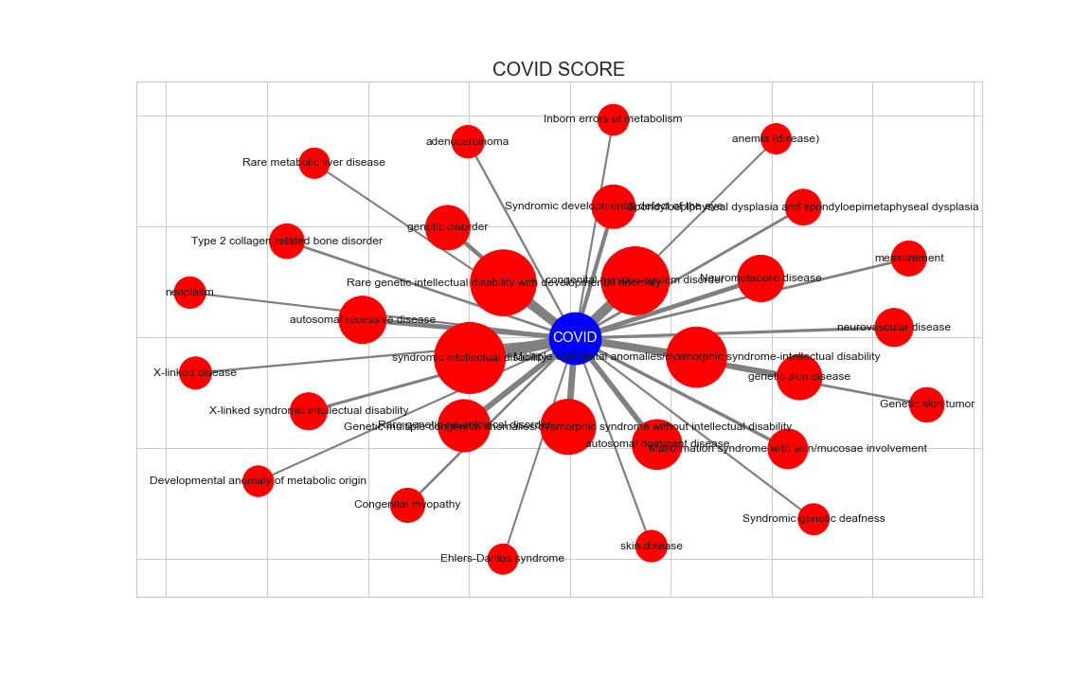
Results

Slide 24
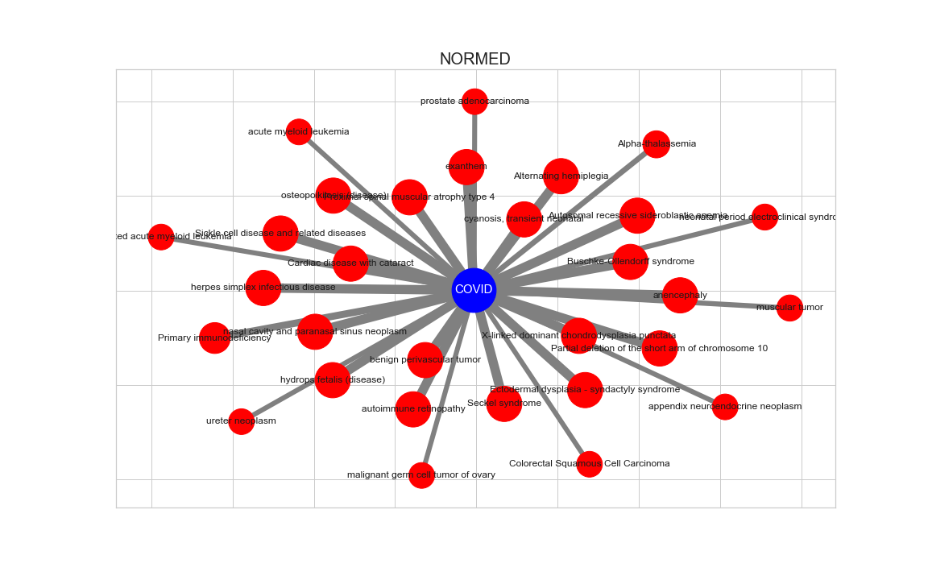
Results

Slide 25
Random Forest Model

Slide 26
Pre-processing
➝ Data set
Self generated
No pre-processing needed
70/30 split for train/test data

Slide 27
Model
➝ Grid search model
Parameters
- Maximum depth
- Number of estimators
- Minimum samples per leaf
385 fits
Notes:
Maximum depth
5 to 15
Number of estimators
10, 20, 50, 100, 200, 500 and 1’000
Minimum samples per leaf
1 to 2

Slide 28
Model
➝ Random search model
Parameters
- Number of estimators
- Maximum depth
- Minimum sample split
- Minimum samples per leaf
- Number of features considered when looking for the best split
25 fits due to simulation length
Notes:
Number of estimators
10 to 1’000, increments of 50
Maximum depth
5 to 20
Minimum sample split
2, 4, 6, 8 and 10
Minimum samples per leaf
1 to 5
Number of features considered when looking for the best split
sqrt, log, None

Slide 29

Results
➝ Grid search
22 targets out of 100 compose 95% of the importance
Lecithin-cholesterol acyltransferase at 12%
Next 18 between 2 and 8%
$r^{2}=\text{0.001369837276703811}$
35% less than baseline

Slide 30
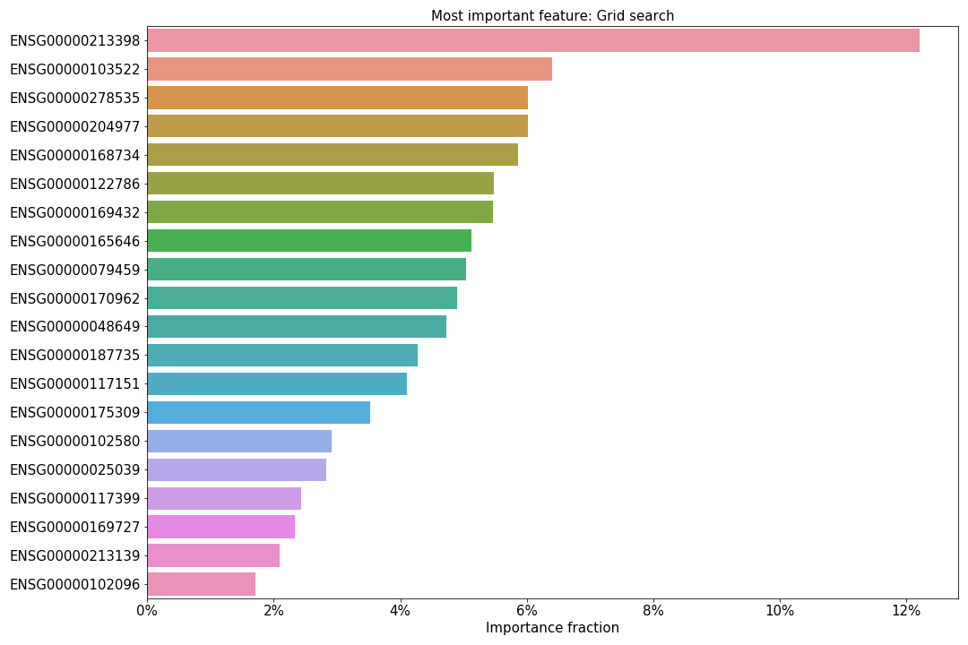
Results

Slide 31

Results
➝ Random search
21 targets out of 100 compose 95% of the importance
Lecithin-cholesterol acyltransferase at 14%
Next 18 between 2 and 8%
$r^{2}=\text{0.00048797298004477074}$
47% less than baseline

Slide 32
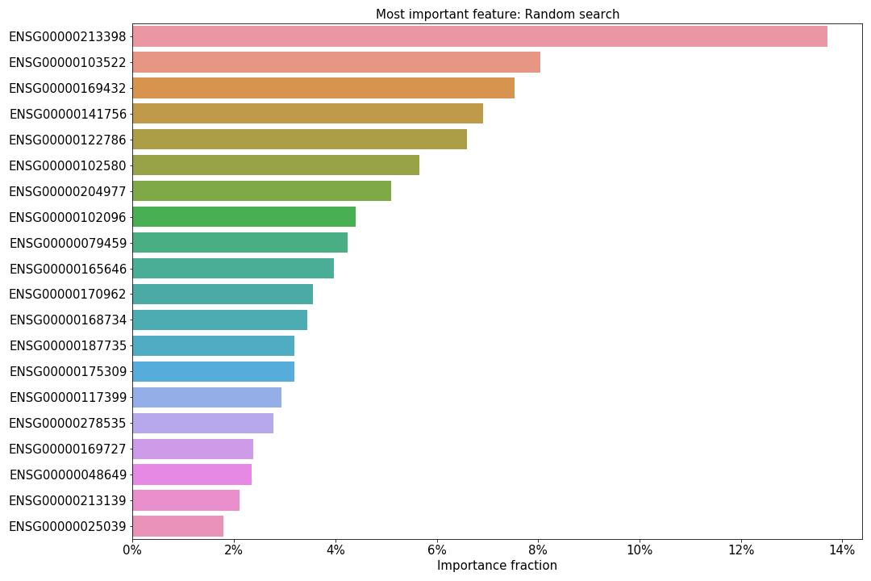
Results

Slide 33
Interpretations

Slide 34
Benefits for the research on the virus
➝ Network analysis
Disease ranking:
- Bone disease, psychiatric disorder, biological process, protein measurement and diabetes mellitus
Target ranking:
- LCAT, SCN9A, SLC18A2, PDGFD and CALD1
➝ Random forest regression
Target identification helps reduce research time and efforts
Reduce costs
Speed up the vaccine development

Slide 35
Improving and reusing the model
➝ Improvements and limitations
Based on the hypothesis that genetics and genomics play a role in the impact on COVID-19
Association score between diseases and COVID-19 built on a partial data-set
Main limitation relying in the amount of data used: targets and diseases
Can be run with a larger amount of data to expect better results

Slide 36
Conclusion

Slide 37
Conclusions
Closest diseases to COVID-19 identified
Most important target risk-factors identified
Reduction of the time spent on vaccine development
Help governments make proportionate decisions

Slide 38
Thank you for your attention
R. Chaouche, Y. Martinson, C. Padovani, J.Triomphe

